Slide 1



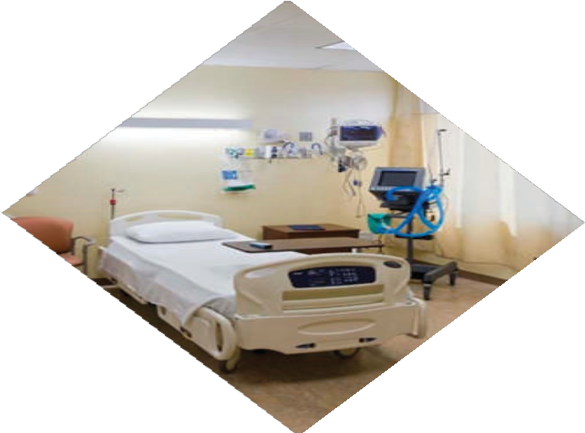





MEDICAL EQUIPMENT PROFILE
www.globaledgebd.com

Slide 2
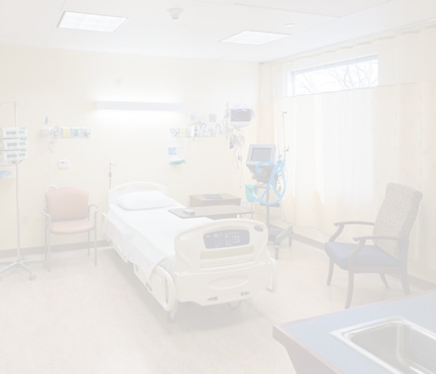
I N T R O D U C T I O N
Global Edge Ltd. is engaged in medical equipment importing, distributing and providing full service to its customers in Bangladesh. As a high-performing organization, GEL partners with government bodies, autonomous institutions, private hospitals and clinics. The products we offer ranges from diagnostics and medical imaging products to therapy devices to surgical instruments and orthopedics to dialysis products and cardiovascular items. With the high level of technological advancement in the global health arena over the recent years where medical devices meet innovative software technology, the health technology sector of Bangladesh is also highly influenced and rapidly improvising to keep up with the exponential growth pace.
AREA OF BUSINESS
Global Edge Medical Equipment operates its core business across three major divisions, segregated by product market and supplies:
Hospital equipment division
Hospital equipment
Hospital furniture
Surgical division
Hospital disposables
Hospital / diagnostics consumables
Why Global Edge:
One-stop source for all hospital and medical requirements through a large product portfolio
Superior quality products with certifications
Competitive product pricing.
Commitment to timely deliveries.
One Call Service Backup.
Strong Distribution Channel.

Slide 3




MISSION
To provide innovative, quality, safe and affordable products through excellent customer responsiveness, leveraging our technological orientation and resource capabilities. We will continue to pivot our business on fostering a deep sense of responsibility towards environmental sustenance and profit sustainability.
VISION
Our vision serves as the framework for our roadmap and guides every aspect of our business by describing what we need to accomplish in order to continue achieving sustainable, quality growth.
CORE V AL UE S
Integrity
Perseverance
Teamwork
Diligence

Slide 4


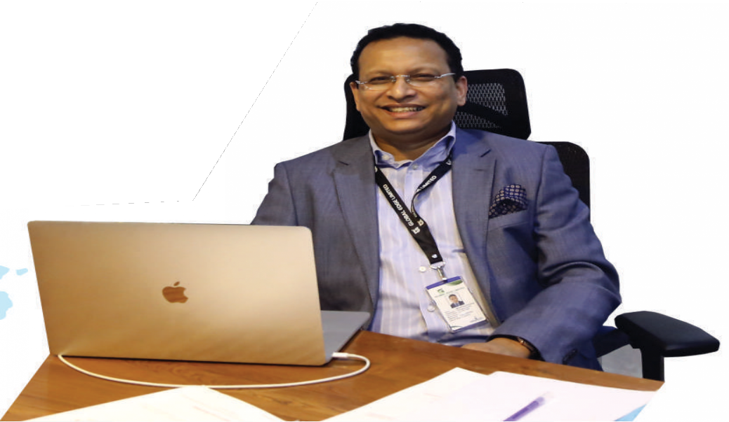
From the Managing Director’s Desk
“We are here to build a great company. A company that has achieved the highest levels of customer satisfaction. A great place to work, a Company that carries itself in the market place with the highest levels of business integrity and business ethics . I take this opportunity
to thank our valued customers, whose continued patronage
and con�idence in our products inspires us to extend the best of services and enables us to provide value for their money.”
Usman Shamsul Hoque
Managing Director

Slide 5













Corporate Organogram
Managing Director
Usman Shamsul Hoque
Sales
Commercial & HR
Service & Engineering
Finance & Accounts
Manager
Deputy Manager
Manager
Service Engineer
Sales Executive
Technician
Executive

Slide 6

Key Milestones
2021
2020
2019
2018
Acquired clients: Prime Diagonstic Center, Medi Future Medical Services, Dr. Sumon Diagonstics Center.
2017
Acquired clients: Bangladesh Specilized Hospital, St. John Vianney Hospital, Square Medical Services, Aichi Hospital Ltd. And many Other Private Hospitals.
2016
Acquired more clients: Bangladesh Submarine Cable Company Limited, Bangladesh Navy, Mansur Ali Medical College & Hospital
Agreement with more foreign Principals and manufacturers.
Bank Asia Foundation, Aloha Sastha Seba Kendra & Hospital.
Commencement of Global Edge Limited Medical Equipment.
Acquired clients: Central Medical Store Depot, Malaysian Field Hospital at Ukhia (Rohingya Camp) and many other
Inception of Global Edge Limited
Started Operation in November
Agreement with well-known foreign
Principals and manufac- turers.
Private Hospitals
Acquired clients: AFC Healthcare, Military Institute of Science & Technology, Directorate General Defence Purchase, Imperial Hospital

Slide 7
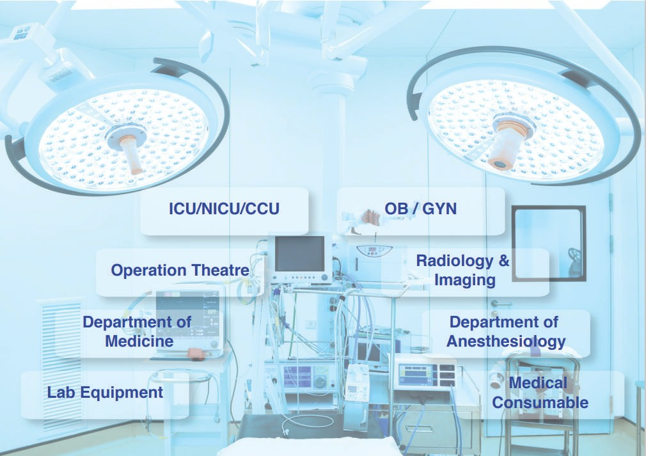

Slide 8



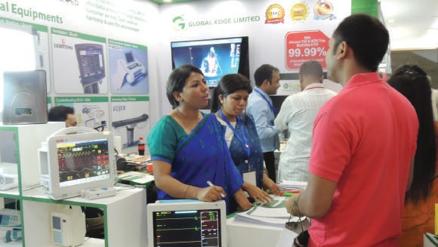
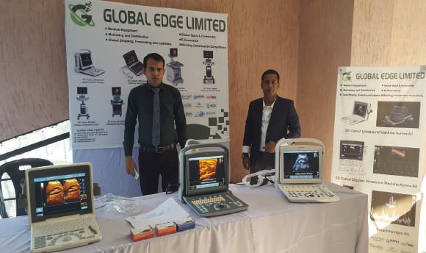
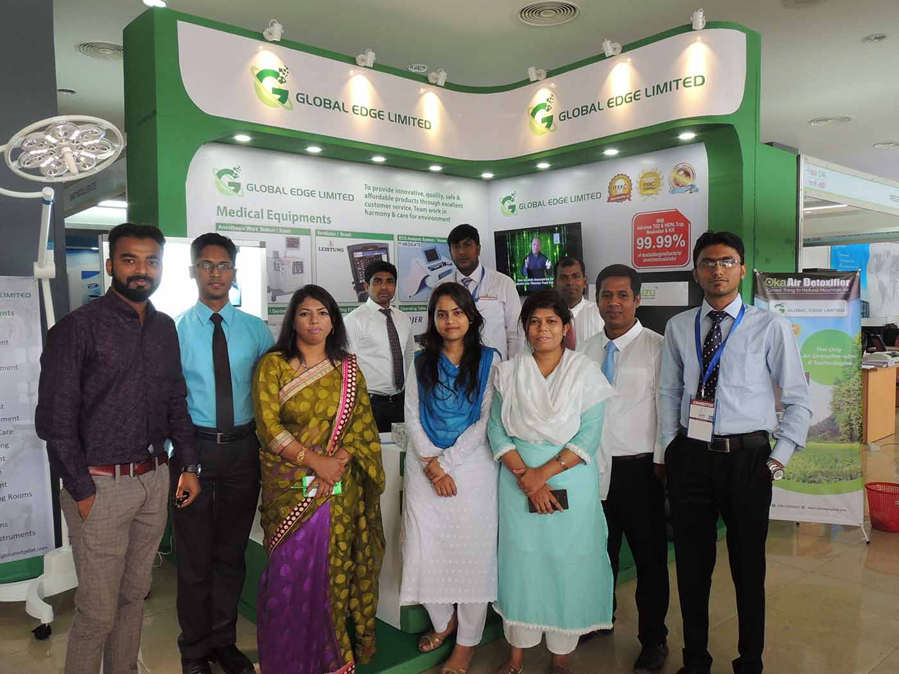
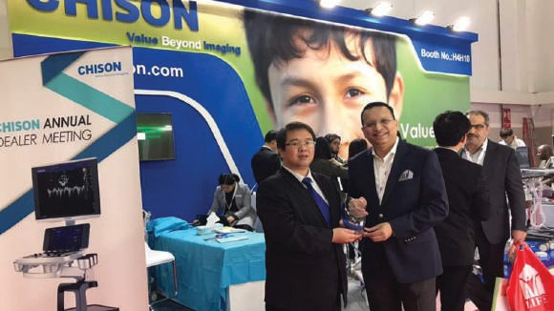
Events & Awards
MediTex Bangladesh, 2017
Society of Nuclear Medicine Bangladesh, 2018
MediTex Bangladesh, 2018
Award receiving from CHISON at
Arab Health Dubai, 2018

Slide 9


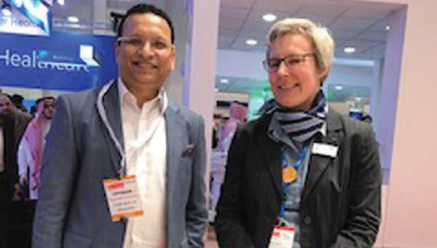
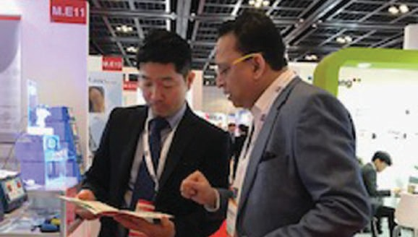


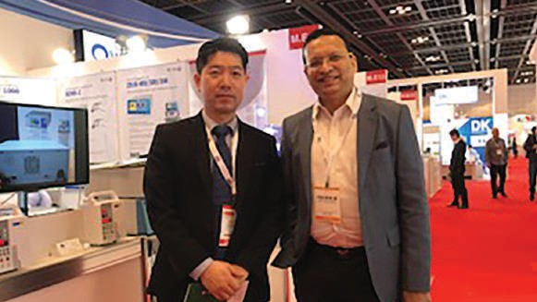
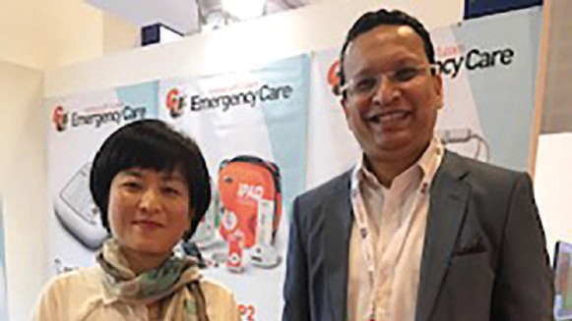
Events & Awards
Arab Health Fair, Dubai, 2019
Arab Health Fair, Dubai, 2019
Arab Health Fair, Dubai, 2019
Arab Health Fair, Dubai, 2019

Slide 10

P r i n c i p a l s & P r o d u c t s
Name of principal and country of origin
Products
Name of principal and country of origin
Products
Planmeca /Finland
Dental unit
Anesthesia machine Patient monitor Laryngoscope
OT table Central station
Anesthesia workstation Suction machine Oxygen flow meter
Infinium Medical/USA
Hersill/Spain
BLT/China Patient monitor
Nasiff Associates/USA
ETT
CEABIS/ Italy Mortuary
AJC/Portugal
Autoclave CSSD
SAIKANG/China
Hospital furniture
Syringe pump ECG, fetal doppler Neonatal items Infusion pump Pulse oximeter Surgical light Fetal monitor Suction machine
PERLONG/China
All hospital and lab equipment
Dixion/Germany
STURDY/Taiwan
All hospital and lab equipment
Vimex /Poland
Endoscopy Laparoscopy
Infant incubator
Infant warming and resuscitation table Phototherapy
Apnea alarm Infusion pump
Euroclinic/Italy
ENT workstation Dental unit
Medicor Elektronika / Hungary
SOMETEC/Korea
Surgical video microscope 3D laparoscopy system
MIXTA TIBBİ /Turkey
Hospital furniture
Steam sterilizer
Low temperature plasma sterilizer Ethylene oxide sterilizer
Dry heat sterilizer and incubator Refrigerator biological
Freezer blood Ultraviolet auto sterilizer Cast cutter
Doppler fetus pulse
Automatic cutting and sealing machine Appliance table
Pres Block S.p.A./Italy
Medical gas outlet
Hanshin Medical Co. Ltd./Korea
Health Well Medical/Korea
Plasma sterilizers
Lojer Oy/Finland
OT table

Slide 11
P r i n c i p a l s & P r o d u c t s
Name of principal and country of origin
Products
Name of principal and country of origin
Products
Infusion pump Ceiling pendants Bed head unit
Technical panel for operating theatre Built-in box
Surgical instrument table Rails and accessories
Analyzer C-arm ECG ETT
Holter
Patient monitor Spirometer
X-ray
EMG and ECT
Foures SAS/France
RMS/India
Flower Medical/China All hospital and lab equipment
Pulse oximeter Patient monitor Vital sign monitor Simulator Analyzer
EEG ECG
Ultrasound
Fetal doppler and monitor Syringe and infusion pump Nebulizer
Metsis/Turkey Defibrillator
US Ophthalmic/USA _{Ophthalmic items}
Contech Medical System Co. Ltd./China
Orthomedical/Germany Surgical implant
Axcent Medical/Germany
Anesthsia machine Ventilator
Patient Montor
Leistung/Brazil | Ventilator
Better Medical/China | Hospital furniture
Daiwha/Korea | Syringe and infusion pump Electrosurgical unit
Biobase/China | Analyzer
Risco/China | Ultrasound machine and Veterinary ultrasound
Bistos/Koria | Patient Montor Fetal Doppler Incubator Photo Therapy Machine Infant Warmer Fetal Monitor Breast Pump Head Lamp
Emaled/Germany | OT Light
S.G. Health Care/Koria | X-Ray Machine
Chison/China | Ultrasound Machine
Alops Corp./Korea ETO plasma

Slide 12

P r i n c i p a l s & P r o d u c t s
Name of principal and country of origin
Products
Name of principal and country of origin
Products
Centrifuge Machine Thermostatic Water Bath Shaking Water Bath Orbital Shakers
Vortex Mixer
Dry Bath Incubator Sterilizer Machine Lab Incubator
Portable Suction Machine
Olive/China
Oxygen Concentrator BIPAP Machine CPAP Machine Nebulizer Machine
Gemmy/Taiwan
Innomed/Hungary Defibrillator
Klaromed/Poland OT Light
JPI/Koria X-ray Machine

Slide 13
S o m e o f O u r V a l u e d C l i e n t s
Client Name
Address
Client Name
Address
Dhaka CMH
Dhaka
City Lab Medical Services | Mirpur, Dhaka
Bangladesh Nevy | Dhaka
Bitmir Ultrasound Training Center | Mohammadpur
AFC Health Ltd. | Gulshan
Jahurul Islam Medical College & Hospital | Kishorganj
BRAC | Dhaka
Shibchor Upozilla Hospital | Madaripur
Philips Electronics Ltd. | Dhaka
MIST | Dhaka
Medilab | Dhaka
Mohammed Ali Hospital | Bogra
Qmed Plus | Bogra
DMCH | Dhaka
CMSD
Dhaka
Malaysian Field Hospital
Ukhiya, Cox’s Bazar
Savar Super Hospital
Savar
CRP( Centre for the Rehabilitation Of the Paralysed)
Savar
Capital General Hospital
Narayangonj
Apan Diagonstic Center
Gazipur
Al-Helal Specialized Hospital
Mirpur, Dhaka
Imperial Hospital
Chittagong
Anowara General Hospital
Narayangonj
Tulip General Hospital
Bogra
KC Hospital
Uttara, Dhaka
Dhalipara Diagonstic center
Narayangonj

Slide 14
S o m e o f O u r V a l u e d C l i e n t s
Client Name
Address
Client Name
Address
Dhaka
Max Hospital | Chottogram
Gazipur Chawrasta Diagonstic & Diabetic Center | Gazipur
Northan Medical College Hospital | Dhaka
Shaheed Zia Medical College | Bogura
Bangladesh Submarine Cable Ltd. | Dhaka
Anwar Holy Health Hospital | Chottogram
Seikh Hasina Burn & Plastic Surgery Hospital | Dhaka
Monsur Ali Medical College | Dhaka
Exim Bank Hospital | Dhaka
Aichi Hospital Ltd | Dhaka
Biogene Pharma Ltd. | Banani, Dhaka
Healthtech | BMA Bhaban, Dhaka
Square Medical Services | Gazipur, Dhaka
Smart Marketing
Desh Traders Ltd.
Sylhet
Medi Trust Health Care Ltd.
Dhaka
Alive Health Care
Dhaka
Life Stream Int.
Dhaka
Belal & Brother
Dhaka
Chevron Hospital
Chottogram
Taj Scientific
Chottogram
Healthtech BD Ltd.
Bangladesh Science House
Dhaka
Good Health Diagonstic Center
Dinajpur
Shaheed Monsur Ali Medical College & Hospital
Dhaka
Bank Asin Foundation
Dhaka

Slide 15
S o m e o f O u r V a l u e d C l i e n t s
Client Name
Address
Client Name
Address
Asgar Ali Hospital
Gendaria, Dhaka
Islam Trading Mirpur, Dhaka
Bangladesh Specilized Hospital
Shamoli, Dhaka
Eltech Engineering Co. Ltd. Gulshan - 1, Dhaka
Items 147
Motijheel, Dhaka
Defense Dynamics Enterprise Gulshan - 1, Dhaka
St. John Vianney Hospital
Tejgoan, Dhaka
Medi Nova Narayangonj
DKMC Hospital
Volta, Narayangonj

Slide 16

L i s t o f P e r s o n a l
Name
Designation
Name
Designation
Nasir A. Choudhury
Chairman
Imtiaz Ahmed
Sr. Executive, Sales Chittagong
Usman Shamsul Hoque
Managing Director
Md. Sohel Parvez
Executive, Sales
Rizwan Mustafiz
Director
Mainul Islam (Rana)
Executive, Sales
Raad Nizam
Executive Director Chittagong
Jahangir Alam
Asst. Manager, Service & Engineering
Fahidul Islam
Manager, Sales
Abu Bakar
Service Engineer
Manager, Commercial & HR
Rajin Rabben Ritu Service Engineer
Mamun Mia
Fouzia Khandokar Shumi
Manager,
Finance & Accounts
Shojib Hosen (Liton)
Technician
Abidur Rahman
Manager,
Service & Engineering
Md. Tafsir Manik
Technician Chittagong
K.M Sohel
Asst. Manager, Sales
Debajit Singha
Asst. Manager, Sales Chittagong

Slide 17














As a responsible corporate engaged in Bangladesh’s health and wellness industry, we are humbly contributing to national development by providing world-class medical products to ensure a healthy and more productive citizenry. Since we are dealing with capital equipment, we are enlisted with several large
Govt./non-Govt./MNCs/semi-Govt. /corporate hospitals that include the following:
ENLISTMENT
CMSD ( Central Medical Stores Depot ) Bangladesh Navy
BGB ( Border Guard Bangladesh )
DGDP ( Directorate General of Defense Purchase ) Bangladesh Atomic Energy Commission
Save the Children
Islami Bank Foundation Hospital
BRB Hospital
BRAC
Asgar Ali General Hospital
Bangladesh Medical Equipment Association
CRP ( Centre For The Rehabilitation Of The Paralysed )

Slide 18

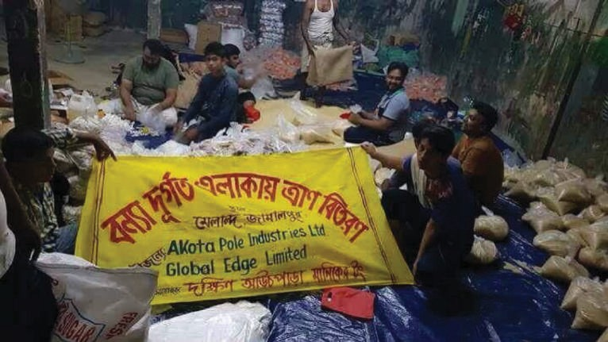

CSR Corporate Social Responsibility
Helping people affected by flood
Certificate of Appreciation Awarded by Serve Human Foundation

Slide 19

Corporate Office
Head Office
Tropical Molla Tower Sha 15/1 - 15/4 , Level-9
Progoti Shoroni, Middle Badda, Dhaka-1212 Telephone: +880 9613050508
Email: info@globaledgebd.com

Slide 20
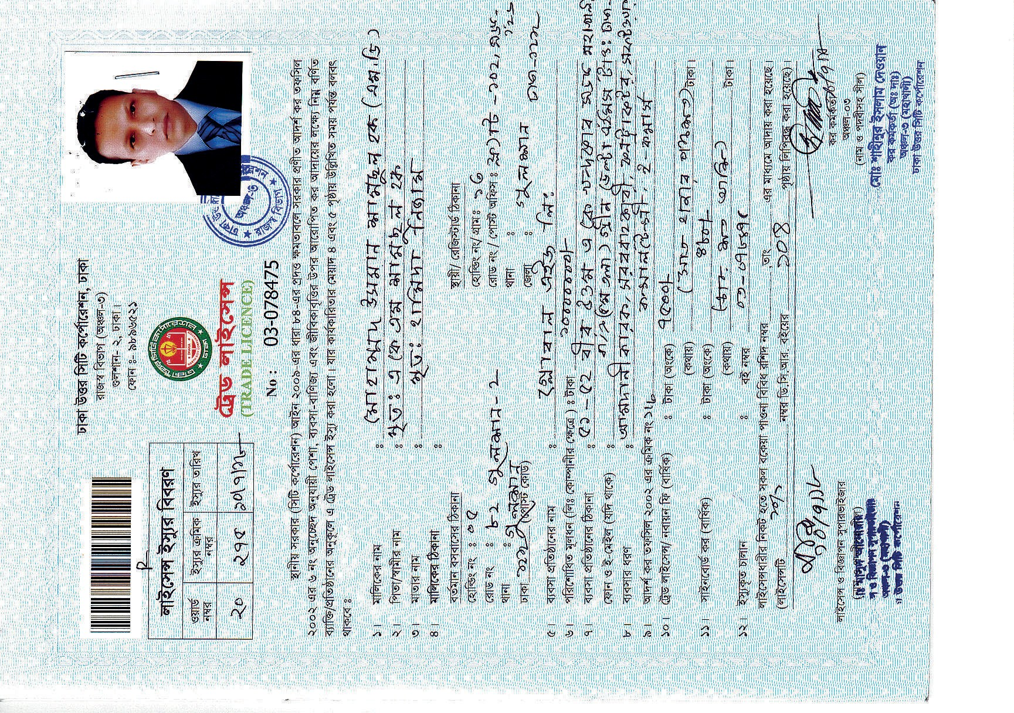

Slide 21
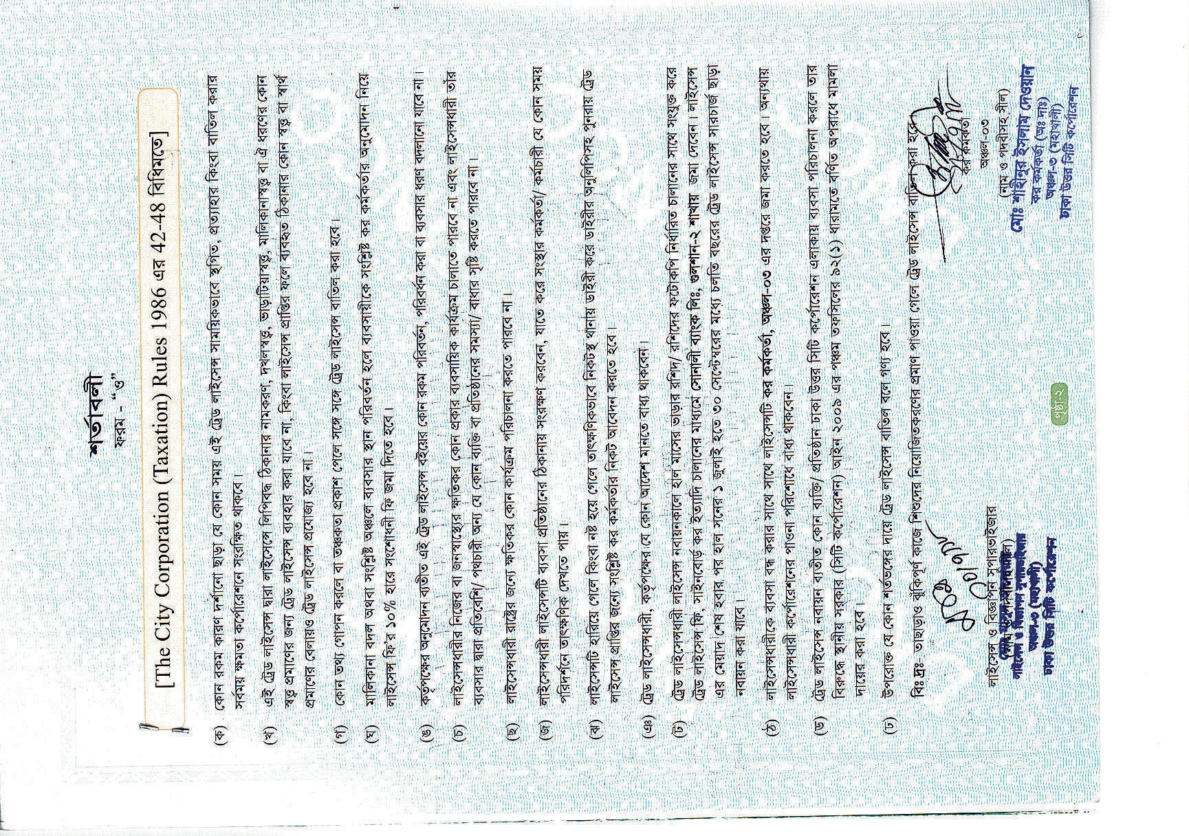

Slide 22
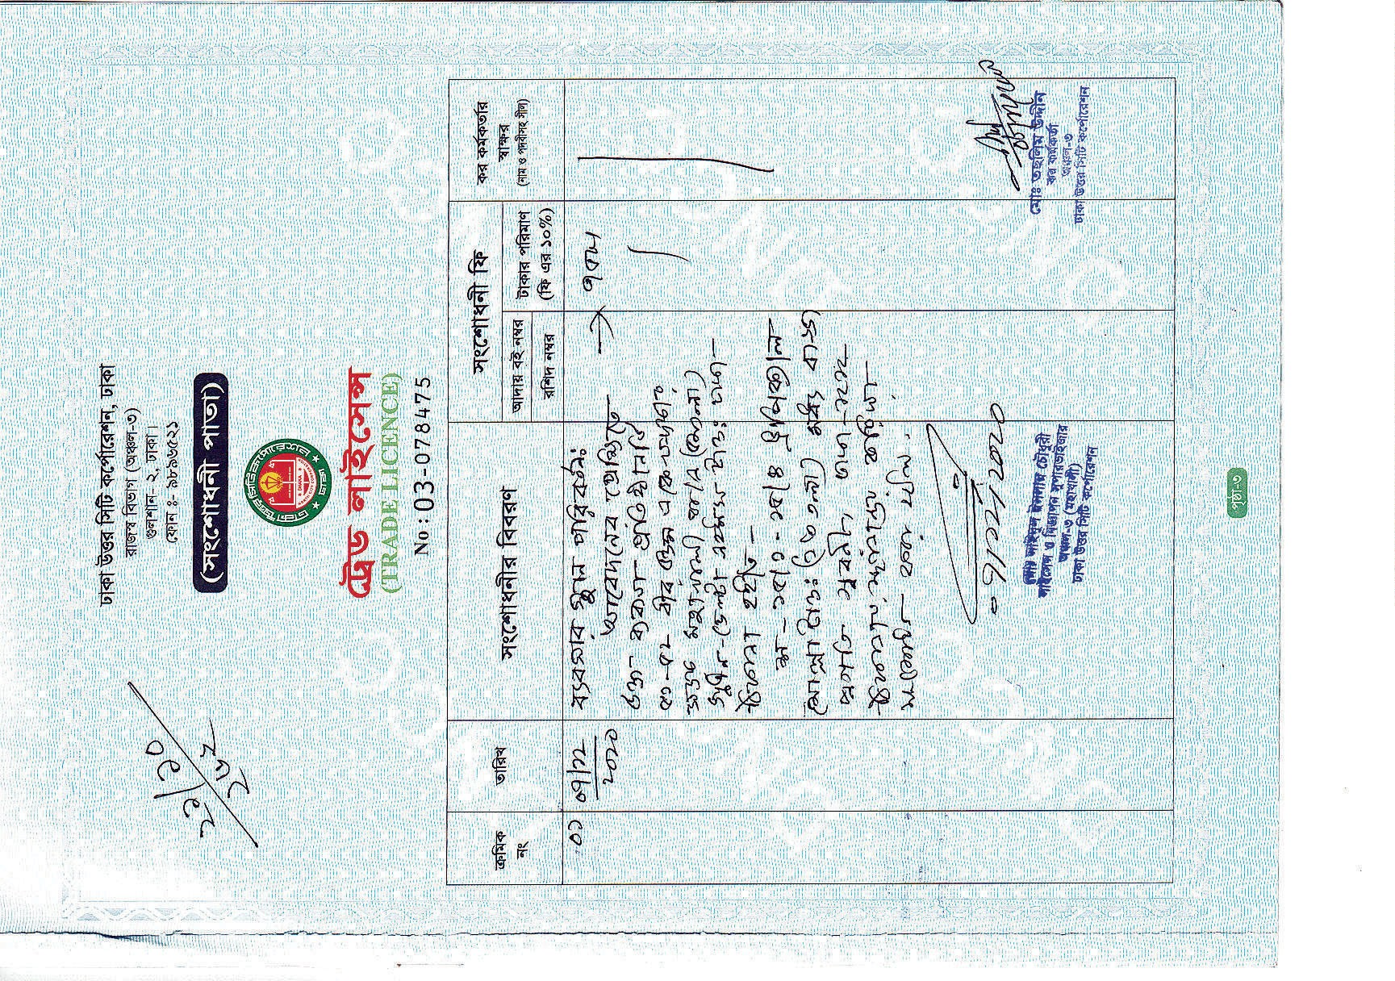

Slide 23
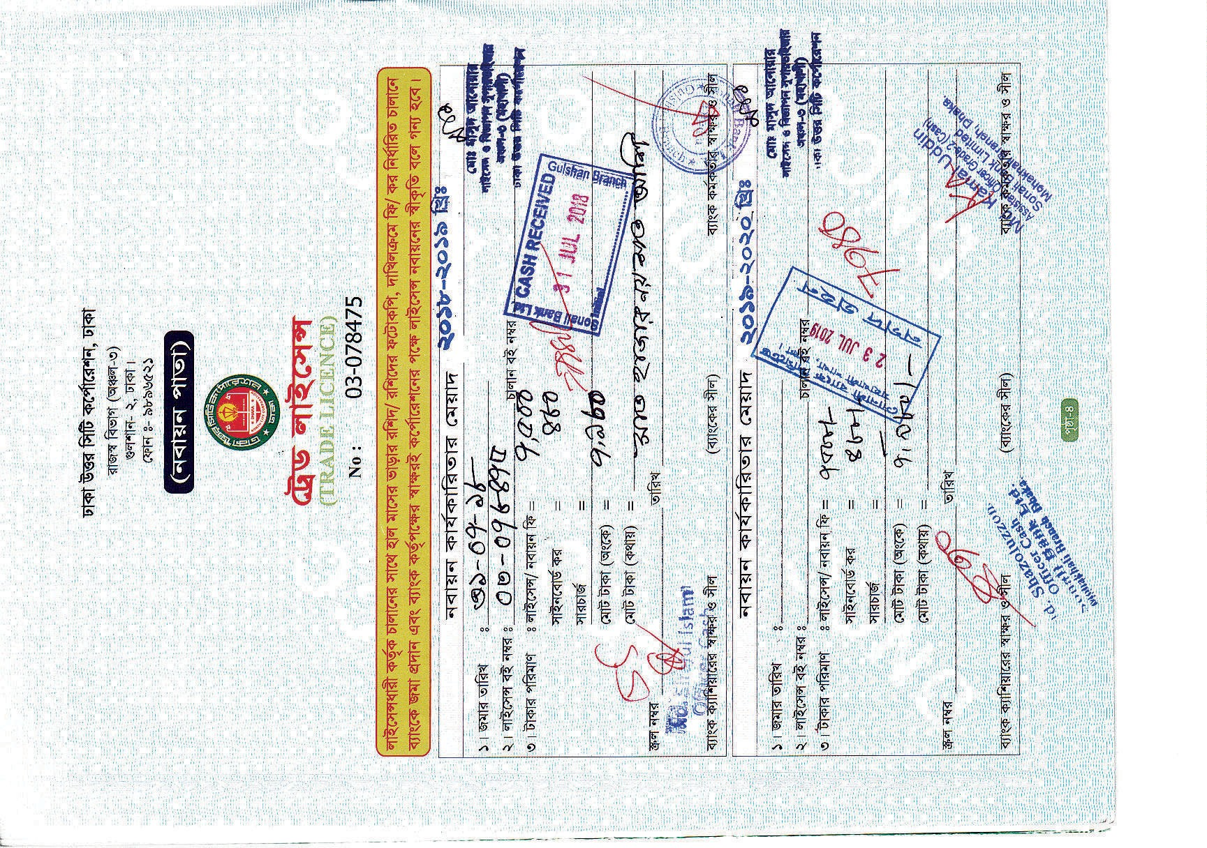

Slide 24
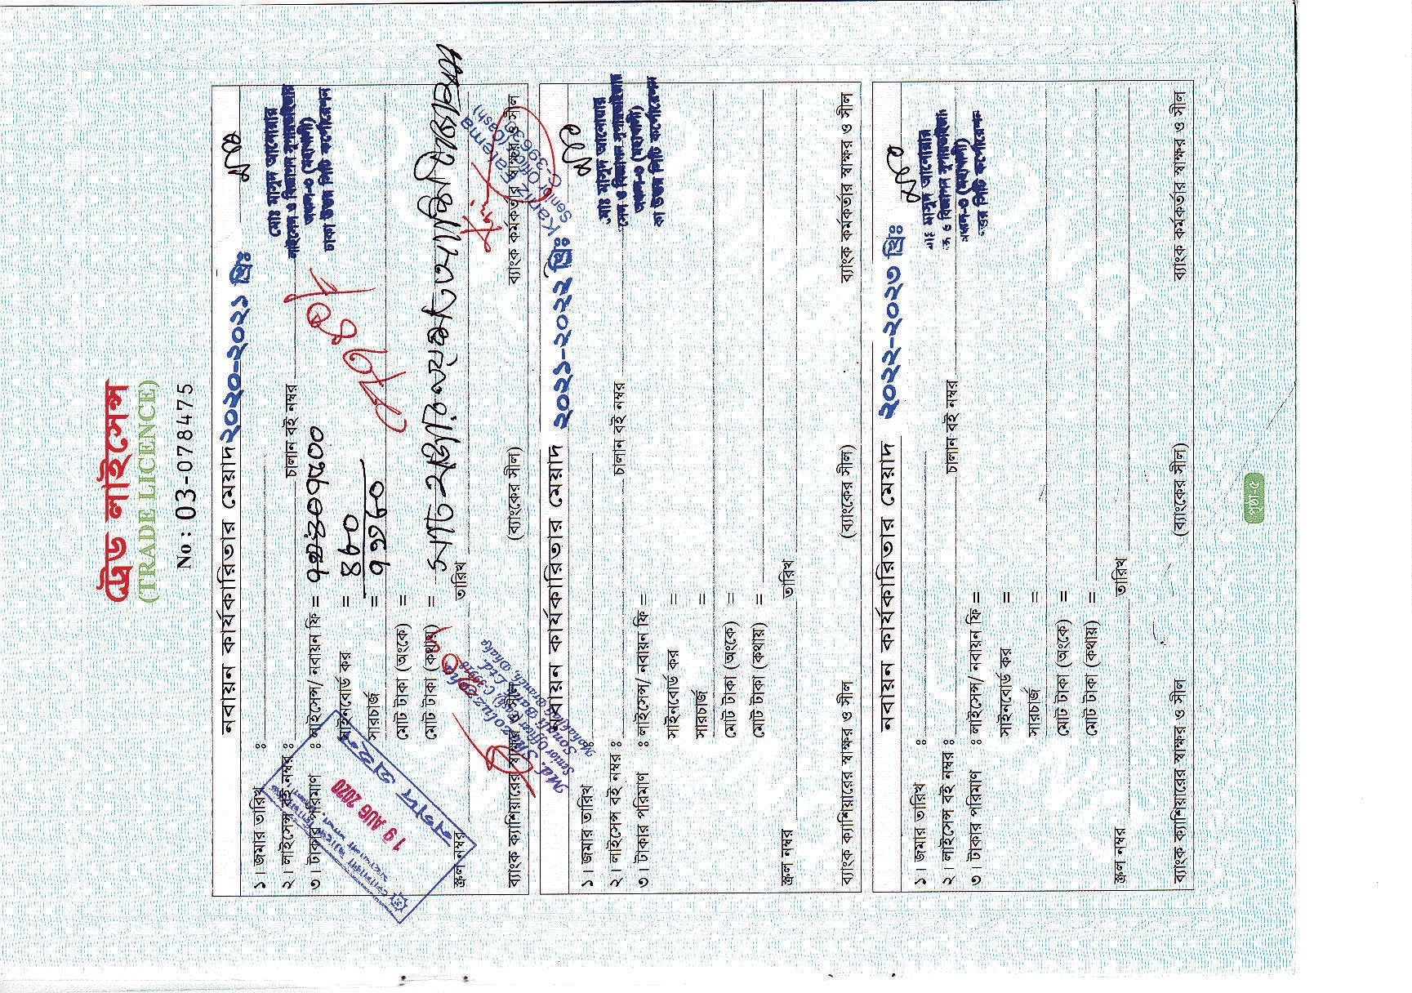

Slide 25
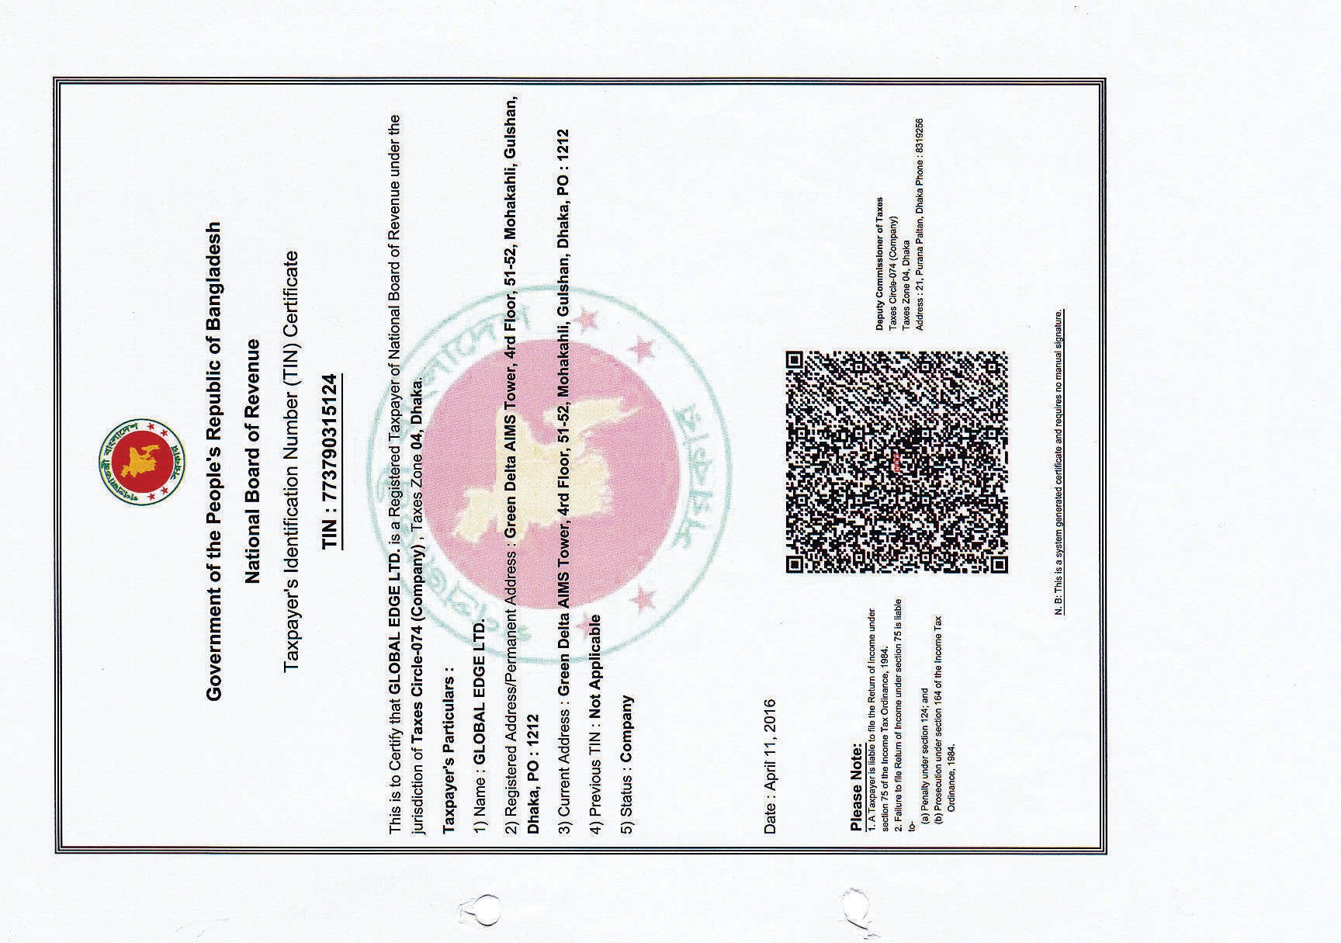

Slide 26
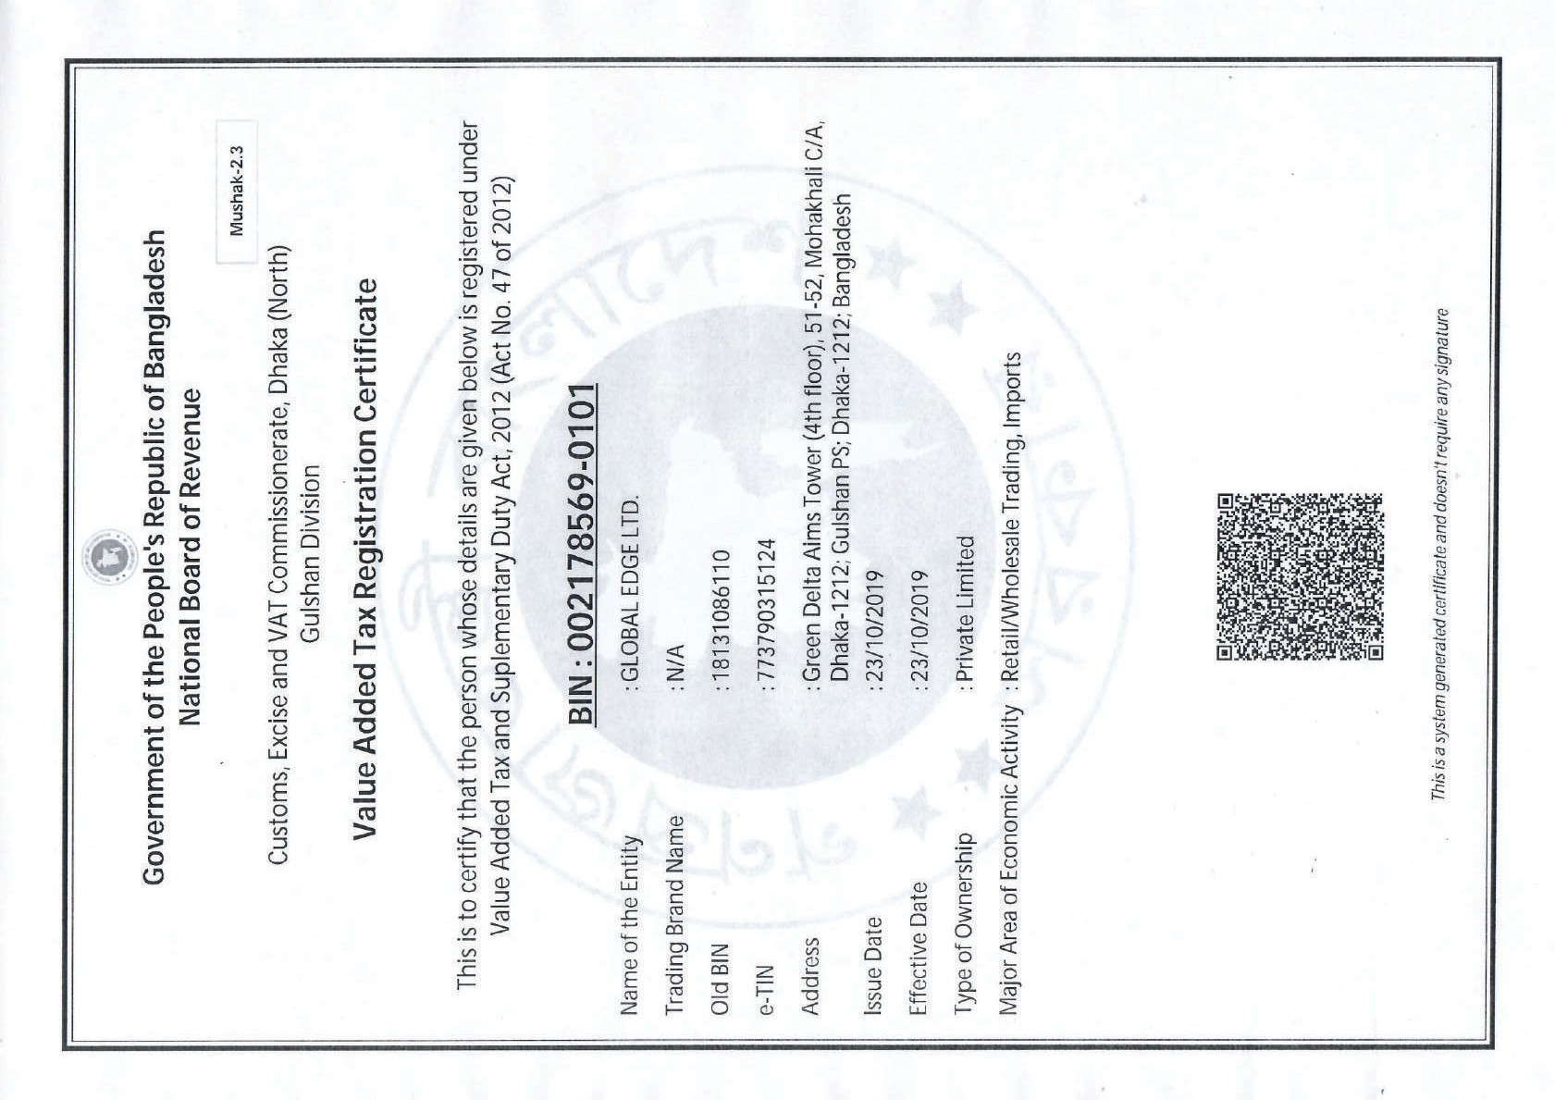

Slide 27


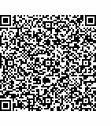
ওএলএম এর বাবায়ন
ঘের বেস সবাহন
Government of the People's Republic of Bangladesh Oﬃce of the Chief Controller of Imports and Exports Import Registration Certiﬁcate (IRC)
Commercial IRC No:
2 | 6 | 0 | 3 | 2 | 6 | 1 | 1 | 0 | 3 | 6 | 5 | 1 | 1 | 9
This is to certify that until further orders Global Edge Ltd., Address: Green Delta Aims Tower, 51-52, Mohakhali C/A, Dhaka-1212 is hereby registered as a Commercial Importer of Oﬃce of the Chief Controller of Imports and Exports under the jurisdiction of Oﬃce of the Controller of Imports and Exports, Dhaka with following terms and conditions.
Company's Particulars:
E-TIN
Previous IRC No
: 773790315124
: BA 120366
3. Nominated Bank Name & Branch : Mercantile Bank Ltd., Mohakhali
Import Slab
First Issue Date
Valid up to
Last Updated Date
: Above 5,00,00,001
: 23 January, 2017
: 30 June, 2021
: 28 October, 2020
Terms & condition:
1. This Registration Certiﬁcate will have to be renewed every ﬁnancial year.
Roni Miah
Executive Oﬃcer Oﬃce of the Controller of Imports and Exports, Dhaka
National Sports Council (NSC) Tower, 62/3, Level-14, Purana Paltan, Dhaka-1000.
2. Prohibited goods cannot be imported and in the case of controlled/restricted goods, all the terms and conditions of the import policy order should be maintained properly.
Without any permission of the Chief Controller of Imports & Exports or any other oﬃcer authorized by him, This Registration Certiﬁcate cannot be transferred.
If any Importer, Exporter & Indentor violates any provisions of the Importers, Exporters & Indentors (Registration) Order, 1981 or any other laws, the registration may be suspended or cancelled.
Any kind of fraud, forgery and misdeclaration is punishable under ICT Act, 2006 and in such cases the registration may be suspended or cancelled by the Authority.
The authority reserves the right to cancel the registration certiﬁcate at any time without assigning any reason whatsoever.
N.B: This is a system generated certiﬁcate requires no manual signature.

Slide 28
